Slide 1

Python Day Intermediate Workshop
WiFi Network: Guest | No Password
Please open https://repl.it and http://bit.ly/scpdi

Slide 2
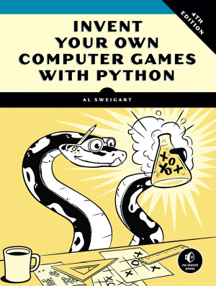
Python Day – Intermediate Workshop
Based on “Invent Your Own Computer Games with Python” – Chapter 13
Get the full book (or read it free online) at https://inventwithpython.com/invent4thed

Slide 3


Slide 4


Slide 5


Slide 6
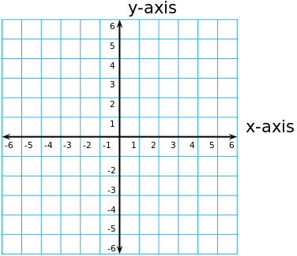
Concept: Cartesian Coordinates

Slide 7
Concept: Cartesian Coordinates

Slide 8
Concept: Cartesian Coordinates

Slide 9
Concept: Pythagorean Theorem
A² + B² = C²
4² + 3² = C²
B
16 + 9 = 25
4² + 3² = 5²
A
C

